Slide 1

Department of Electronics and Telecommunication
Design Workshop Project(ETR6L4)
Project Name - Bi-Directional Visitor Counter
Institute of Engineering and Technology, Devi Ahilya Vishwavidyalaya

Slide 2
Contents
Aim of the Project
Components Required
Introduction
Block Diagram
Circuit Diagram
Simulation
code
Working
Advantages and Limitations
Applications

Slide 3
Aim of the Project
The aim of our project is to make a controller which can sense if any person enters the room and it lights up the room automatically and also counts how many person are entering the room or going out of it.
A bidirectional visitor counter using Arduino is a reliable circuit that takes over the task of counting a number of Persons/ Visitors in the Room very accurately. if somebody enters into the Room then the Counter is incremented by one and also leaves it would be decremented. The total number of persons inside the Room is Shows on the 16X2 LCD module.
It is made to prevent unwanted electric power waste in schools, colleges, offices and houses. This whole process is operated automatically by its sensors.

Slide 4
Components Required
Hardware Components
Arduino UNO
IR Sensor Module
16x2 LCD Display
Relay Module

Slide 5
Introduction
In today’s world, there is a continuous need for automatic appliances.
The objective of this project is to make a controller based model to count number of persons visiting particular room and accordingly light up the room automatically.
Here we are using sensor and controller to count the no of persons in the room and display it on LCD.
If there is at least 1 person in the room, the lights will be on else it will remain off

Slide 6
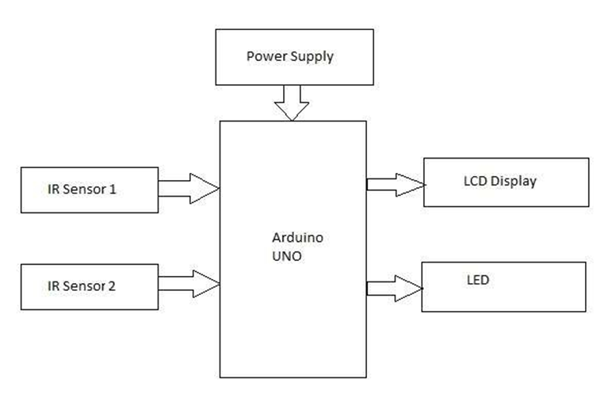
Block Diagram
Relay Module

Slide 7
Arduino Code
void setup()
{
lcd.begin(16,2);
lcd.print("Visitor Counter");
delay(2000);
pinMode(in, INPUT); // Assign the IR is Input
pinMode(out, INPUT);//Assign the IR is Input
pinMode(relay, OUTPUT); //Assign the Relay is output
lcd.clear();
lcd.print("Person In Room:");
lcd.setCursor(0,1);
lcd.print(count);
}
void loop()
{
if(digitalRead(in))
IN();
if(digitalRead(out))
OUT();
if(count<=0)
{
lcd.clear();
digitalWrite(relay, LOW); // relay is in ON conditon
lcd.clear();
lcd.print("Nobody In Room");
lcd.setCursor(0,1);
lcd.print("Light Is Off");
delay(2000);
}
else
digitalWrite(relay, HIGH); // relay is OFF condition
}
#include<LiquidCrystal.h>
LiquidCrystal lcd(13,12,11,10,9,8);
#define in 7 // Analog pin A0 has a IR Module attached to it.
#define out 6 // Analog pin A1 has a IR Module attached to it.
#define relay 2 // Digital pin D2 has a Relay attached to it.
int count=0;
void IN()
{
count++; // increment the value
lcd.clear();
lcd.print("Person In Room:");
lcd.setCursor(0,1);
lcd.print(count);
delay(2000);
}
void OUT()
{
count--; // increment the value
if(count<0)
count = 0;
lcd.clear(); // Clear the LCD Value
lcd.print("Person In Room:");
lcd.setCursor(0,1); // set the cursor positon
lcd.print(count); // Display count value
delay(2000);
}

Slide 8
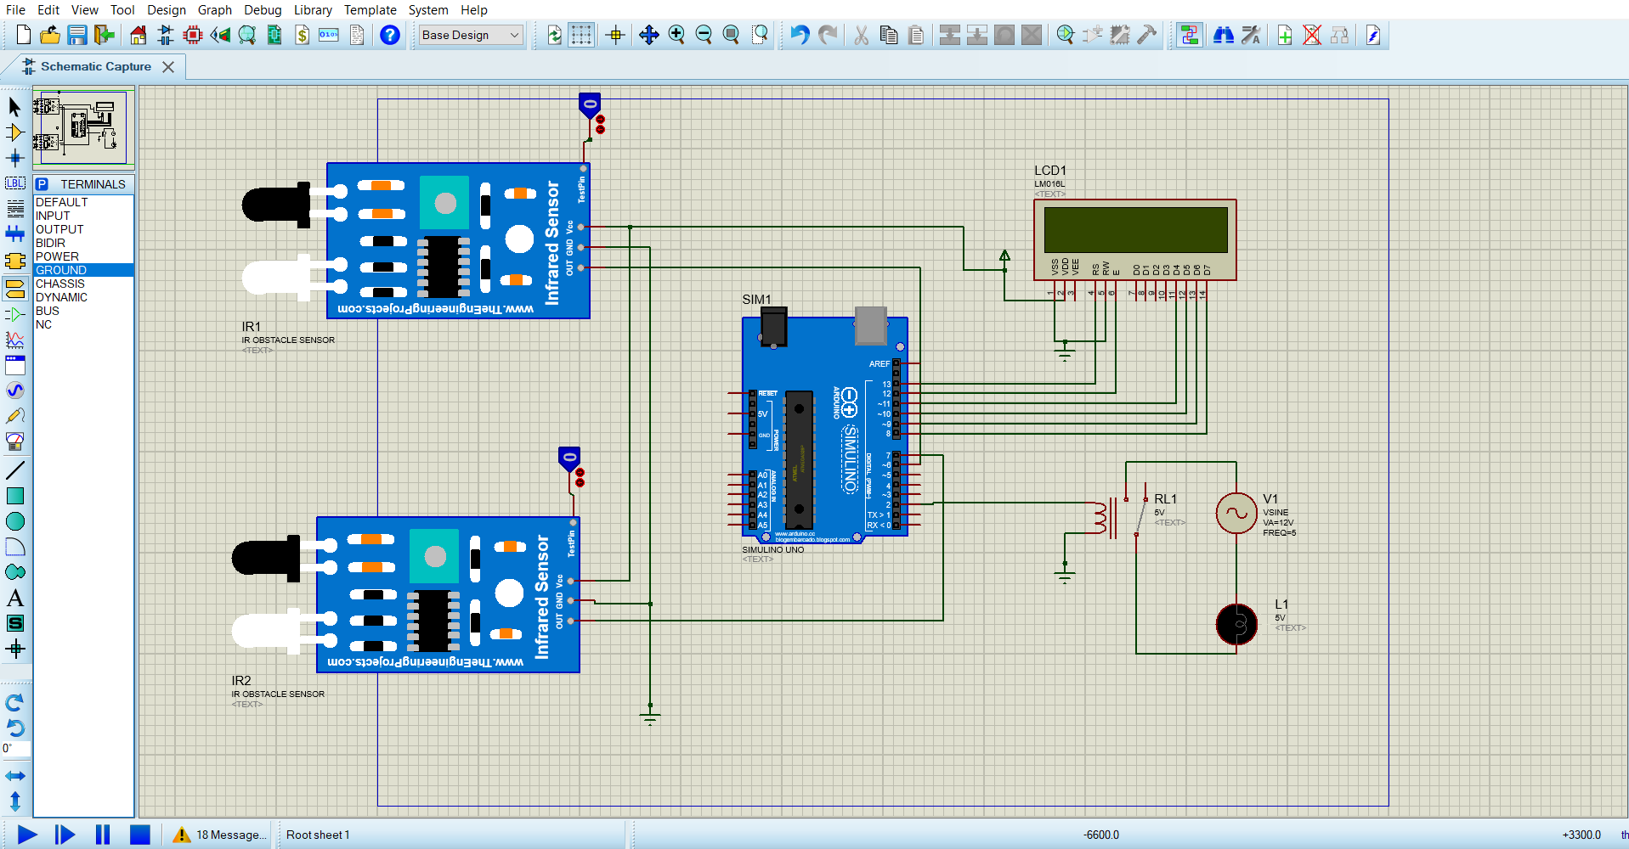
Schematic Diagram

Slide 9
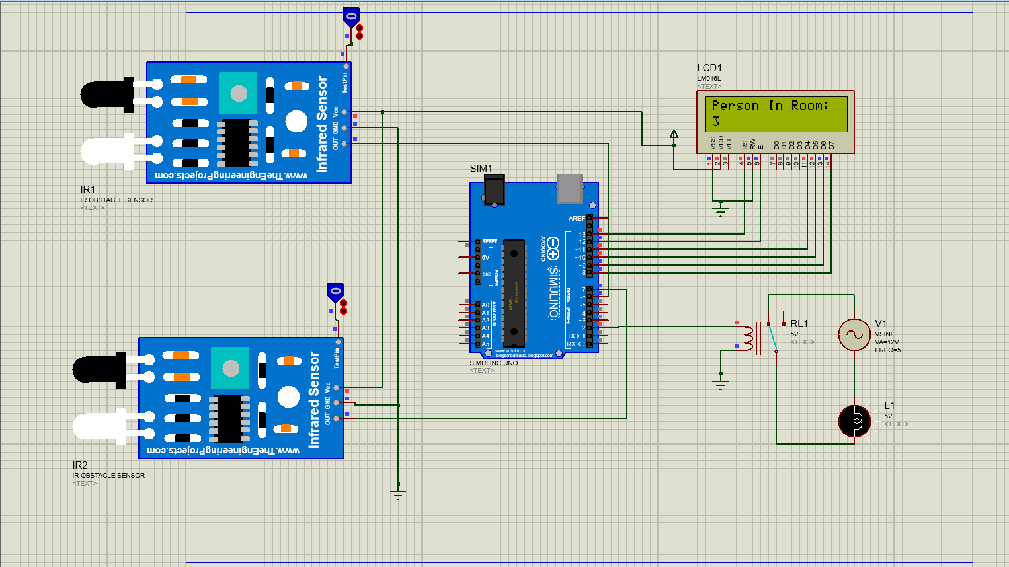
Simulation

Slide 10
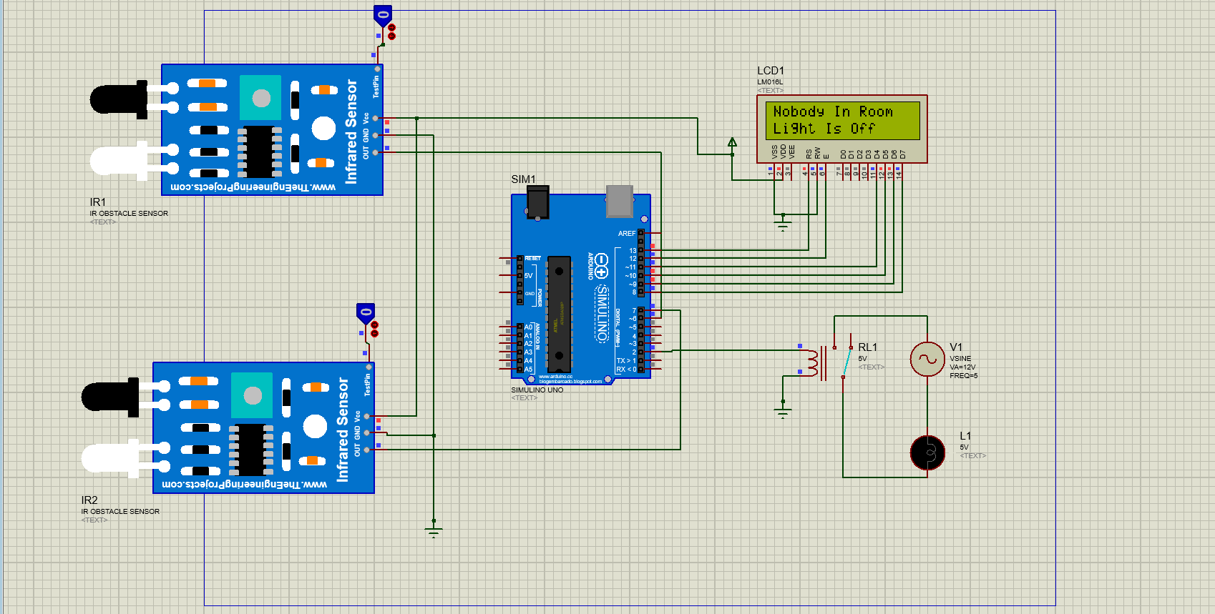
Simulation

Slide 11
Working
The IR sensor continuously senses the presence of any obstacles (a person in our case ).
If sensor 1 senses a person, it informs the controller that a persons entered so that controller can increment the count. At the same time it gives a delay of 1 sec so that the person can cross the sensor 2 and the count is maintained correctly.
When a person exits, the sensor 2 informs the controller to decrement the count. Similarly it also provides a delay of 1 sec to maintain count properly.
The count is displayed on LCD by the controller.
If there is at least 1 person is inside the hall, an LED will glow otherwise it is off.

Slide 12
Advantages Limitations
Can be used for automatic room light control.
It will help to save electricity. When no one is there in room the appliances will be off.
In School/companies it will help to check if somebody is there in the zone or not. If the data on display unit is zero the security guards can shut the gate easily.
It is used only when one person cuts the rays of the sensor hence cannot be used when two or more persons cross the door simultaneously Arduino UNO
When anybody is inside the room and we need to switch off the power then we’ve to do it manually. So, in this case we fail to automatically control the light 16x2 LCD Display

Slide 13
Applications
This circuit can be used domestically to get an indication of number of persons entering a party.
It can be used at homes and other places to keep a check on the number of persons entering a secured place.
It can also be used as home automation system to ensure energy saving by switching on the loads and fans only when needed.

Slide 14
Thank You

